Slide 1
Using a Simple GUI

Slide 2
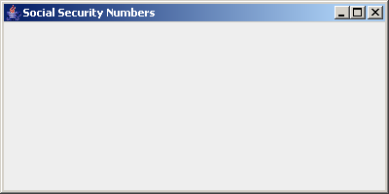
Creating a JFrame
public static void initialize() {
mySSNGUI=new JFrame();
mySSNGUI.setSize(400, 200);
mySSNGUI.setLocation(100, 100);
mySSNGUI.setTitle("Social Security Numbers");
mySSNGUI.setDefaultCloseOperation(JFrame.EXIT_ON_CLOSE);
mySSNGUI.setVisible(true);
}
mySSNGUI
This area is the
ContentPane
Notes:
Size is 400px length and 200px width.

Slide 3
Putting data in a JFrame
public static void printSSNtoJFrame
(JFrame jf, String[] list, int size) {
Container myContentPane = jf.getContentPane();
TextArea myTextArea = new TextArea();
myContentPane.add(myTextArea);
for (int i=0;i<size;i++)
if (!isValidSSN(list[i]))
myTextArea.append("Invalid SSN: "+list[i]+"\n");
else
myTextArea.append(list[i]+"\n");
jf.setVisible(true);
}

Slide 4
Container myContentPane = jf.getContentPane();
myContentPane

Slide 5
Container myContentPane = jf.getContentPane();
myContentPane
TextArea myTextArea = new TextArea();
myTextArea

Slide 6
myContentPane.add(myTextArea);
myContentPane
myTextArea
myTextArea.append(“Hello\n”);
myContentPane
Hello
myTextArea

Slide 7
It is more common for the "main" application and the GUI to be separate classes.
Main
Instantiates GUI
Has object reference to GUI
Manipulates GUI
GUI Object
Title
Content Pane
Window Close
Etc.
mySSNGUI
public class SSN {…
mySSNGUI = new Jframe();
mySSNGUI = new SSNGUI();
public class SSNGUI {…

Slide 8
public class SSNGUI {…
But do we have to write code here for all things a GUI (JFrame) can do?
}
NO! We can take advantage of the most powerful
Object-Oriented feature…
Inheritance
public class SSNGUI extends JFrame{…
}

Slide 9
public class SSNGUI extends JFrame{…
}
The class SSNGUI can now do whatever a JFrame can do, as well as whatever we add to it.
public static void initialize() {
mySSNGUI=new SSNGUI();
mySSNGUI.setSize(400, 200);
mySSNGUI.setLocation(100, 100);
mySSNGUI.setTitle("Social Security Numbers");
mySSNGUI.setDefaultCloseOperation(JFrame.EXIT_ON_CLOSE);
mySSNGUI.setVisible(true);
}

Slide 10
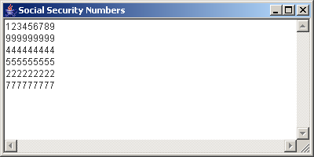
The program SSNFrame3 produces this SSNGUI:
The entire ContentPane is one TextArea

Slide 11
To "divide" the ContentPane into different areas, we can use a LayoutManager
There are several LayoutManagers available, including
BorderLayout
GridLayout

Slide 12
BorderLayout
North
West
Center
East
South
Notes:
Border layout divides the contentPane into 5 parts.

Slide 13
public static void printSSNtoSSNGUI
(SSNGUI ssnGUI, String[] list, int size) {
Container myContentPane = ssnGUI.getContentPane();
TextArea myTextArea = new TextArea();
TextArea mySubscripts = new TextArea();
myContentPane.add(myTextArea, BorderLayout.EAST);
myContentPane.add(mySubscripts, BorderLayout.WEST);
for (int i=0;i<size;i++) {
mySubscripts.append(Integer.toString(i)+"\n");
if (!isValidSSN(list[i]))
myTextArea.append("Invalid SSN: "+list[i]+"\n");
else
myTextArea.append(list[i]+"\n");
}
ssnGUI.setVisible(true);
Notes:
“EAST” and “WEST” are location where the content will go.

Slide 14
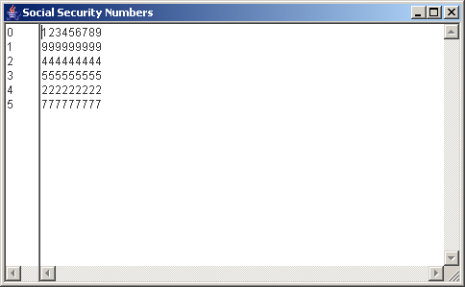

Slide 15
mySSNGUI.setLayout(new GridLayout(1,2));
Notes:
GridLayout(1,2) : 1 row, 2 columns.

Slide 16
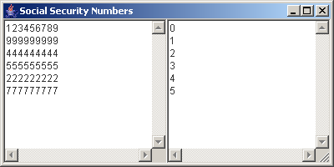
myContentPane.add(myTextArea);
myContentPane.add(mySubscripts);
for (int i=0;i<size;i++) {
mySubscripts.append(Integer.toString(i)+"\n");
if (!isValidSSN(list[i]))
myTextArea.append("Invalid SSN: "+list[i]+"\n");
else
myTextArea.append(list[i]+"\n");
}

Slide 17
Non-application Classes (no "main" method)
Classes without "main" methods are true objects
They cannot exist without being instantiated
They may inherit from other classes so little extra code must be written
When an object is instantiated, a special method called a "constructor" is automatically executed.
The name of the constructor is the same as the name of the class.

Slide 18
import javax.swing.*;
public class SSNGUI extends JFrame {
public SSNGUI () {
}
}
The constructor has the same name as the class
The constructor has no "return" attributes
The constructor is the initialization method for the object
The constructor may take parameters from the instantiating method for initial values

Slide 19
import javax.swing.*;
public class SSNGUI extends JFrame {
public SSNGUI(String title) {
setTitle(title);
}
import javax.swing.*;
public class SSNGUI extends JFrame {
public SSNGUI(String title, int height, int width) {
setTitle(title);
setSize(height, width);
}

